Slide 1
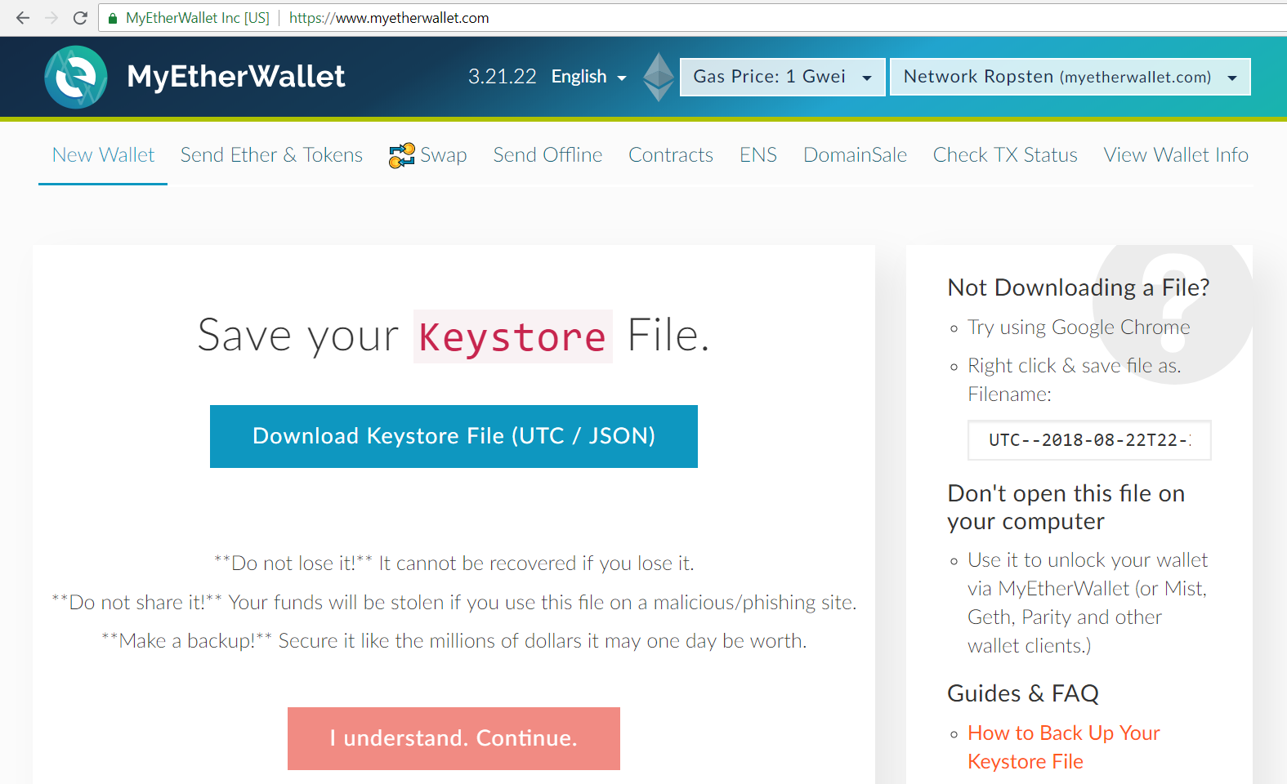
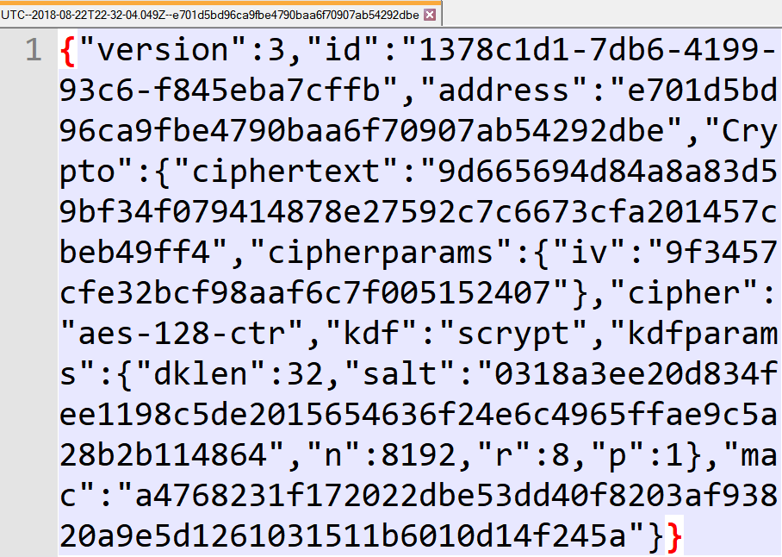
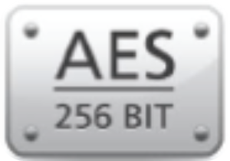
Ethereum UTC / JSON Wallet Encryption (AES + Scrypt + HMAC)

Slide 2
Ethereum UTC / JSON Wallets
Ethereum wallets use standard UTC / JSON encrypted formats
Keep the encrypted private keys (or wallet seed words)
Used in: MyEtherWallet, geth, Mist, Parity, MetaMask , ethers.js
The data inside the JSON file is strongly password-protected
The UTC / JSON file defines:
Key-derivation function (KDF), usually "scrypt" + KDF parameters
Cipher algorithm (e.g. AES-128-CTR) + parameters
Encrypted message (ciphered text)
Message authentication code (MAC)

Slide 3
MyEtherWallet and JSON Wallets
Live Demo

Slide 4
Ethereum UTC / JSON Wallet Encryption
{ "version": 3, "id": "…", "address": "b97e993872a9050c07f…ef195",
"Crypto": {
"ciphertext": "bc9215b2cd1571df…e3a1", // the encrypted private key
"cipher": "aes-128-ctr", // AES, 128-bit encryption, CTR mode
"cipherparams": { "iv": "2bac08cafc…8e" }, // random initial vector
"kdf": "scrypt", "kdfparams": {
"dklen": 32, // key length (256-bit key for AES encryption)
"salt": "7d48230c94b90c0301bf9f4…eba1", // random-generated salt
"n": 1024, // iterations count (CPU + memory cost factor)
"r": 8, // block size (affects CPU + memory)
"p": 1 // parallelization factor (threads count)
},
"mac": "e3cd7ea4e3ceb0e9a…0564" // msg integrity key (password check)
} }
Learn more at: https://github.com/ethers-io/ethers.js/blob/master/wallet/secret-storage.js#L288

Slide 5

Ethereum UTC / JSON Wallet Encryption
Try the Demo!

